Slide 1
PSF json attribute
Attribute | Required? | Description
Equation | Yes | Equation to calculate PSFBase.
HighLimit | Yes | Upper Limit (max) of PSFToApply.
LowLimit | Yes | Lower limit (min) of PSFToApply.
“Equation” Explaination:
PSFBase
= ToDouble(GetDelimitedData([DFF_SSA1_S], '|', 0)) * 0.5 + ToDouble(GetDelimitedData([DFF_SSA1_S], '|', 3)) / 2
Assume,
This DFF token [DFF_SSA1_S] is “0.70|20|1.3044300079345703|0.5”.
GetDelimitedData([DFF_SSA1_S], '|', 0) = 0.70|20|1.3044300079345703|0.5 = 0.7
GetDelimitedData([DFF_SSA1_S], '|’, 3) = 0.70|20|1.3044300079345703|0.5 = 0.5
ToDouble(0.7) will convert string “0.7” to double. As applied to “0.5”.
= 0.7 * 0.5 + 0.5 / 2
= 0.35 + 0.25
= 0.6
PSFToApply = PSFBase * PSFMultiplier
PSFToApply is the PSF value applied to specified PowerSumPin and Test instances that matched the Test Regex.

Slide 2
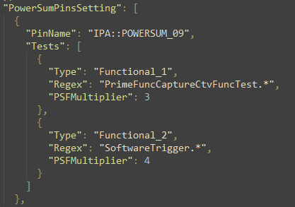
PowerSumPinsSetting json attribute
Attribute | Required? | Description
PinName | Yes | Single PowerSumPin name.
Tests | Yes | Test instance to apply
Test:Type | Yes | Tag for the test.
Test:Regex | Yes | Regex to get matching test instances. If PinName contain scope. ex. “IPA::POWERSUM_09” The matching test instance must have scope. ex. Regex “PrimeFuncCaptureCtvFuncTest.*” Matched Test instance. ex. “IPA::DevicePowerScalerIP::PrimeFuncCaptureCtvFuncTest_P1”
Test:PSFMultiplier | Yes | PSF Multiplier apply to PSFBase.

Slide 3
PowerSumPinsSetting json attribute
TestMethod found configured pin name has scope. PinName=[IPA::POWERSUM_09] has scope. PinName=[IPB::POWERSUM_09] has scope.
TestMethod attempt to get matching test instance name. PinName=[IPA::POWERSUM_09] PinScope=[IPA] TestType=[Functional_1] TestRegex=[PrimeFuncCaptureCtvFuncTest.*] TestFound #[4] IPA::DevicePowerScalerIP::PrimeFuncCaptureCtvFuncTestDtsProcessing_P1,IPA::DevicePowerScalerIP::PrimeFuncCaptureCtvFuncTestWithTailBiggerThanActualCtv_P1, IPA::DevicePowerScalerIPA::PrimeFuncCaptureCtvFuncTestWithTailSmallerThanActualCtv_P1,IPA::DevicePowerScalerIP::PrimeFuncCaptureCtvFuncTest_P1 TestType=[Functional_2] TestRegex=[SoftwareTrigger.*] TestFound #[3] IPA::DevicePowerScalerIP::FuncWithSoftwareTrigger_P1,IPA::DevicePowerScalerIP::SoftwareTriggerCommonParam_ParamIsEmpty_P1, IPA::DevicePowerScalerIP::SoftwareTriggerCommonParam_SetCallbackAndExecute_P1 PinName=[IPB::POWERSUM_09] PinScope=[IPB] TestType=[Functional_1] TestRegex=[PrimeFuncCaptureCtvFuncTest.*] TestFound #[4] IPB::DevicePowerScalerIP::PrimeFuncCaptureCtvFuncTestDtsProcessing_P1,IPB::DevicePowerScalerIP::PrimeFuncCaptureCtvFuncTestWithTailBiggerThanActualCtv_P1, IPB::DevicePowerScalerIP::PrimeFuncCaptureCtvFuncTestWithTailSmallerThanActualCtv_P1,IPB::DevicePowerScalerIP::PrimeFuncCaptureCtvFuncTest_P1 TestType=[Functional_2] TestRegex=[SoftwareTrigger.*] TestFound #[3] IPB::DevicePowerScalerIP::FuncWithSoftwareTrigger_P1,IPB::DevicePowerScalerIP::SoftwareTriggerCommonParam_ParamIsEmpty_P1, IPB::DevicePowerScalerIP::SoftwareTriggerCommonParam_SetCallbackAndExecute_P1
If there is duplicate test instance name found, test method will throw TestMethodException.
TestMethod calculate PSFToApply for each test. PinName=[IPA::POWERSUM_09] TestType=[Functional_1] PSFToApply=[1.8] => This means the #4 matched test instances will apply PSF 1.8 to pin IPA::POWERSUM_09. PinName=[IPA::POWERSUM_09] TestType=[Functional_2] PSFToApply=[2.4] PinName=[IPB::POWERSUM_09] TestType=[Functional_1] PSFToApply=[3] PinName=[IPB::POWERSUM_09] TestType=[Functional_2] PSFToApply=[3.6] PSFToApply = PSFBase * PSFMultiplier = 0.6 * 3 = 1.8

Slide 4
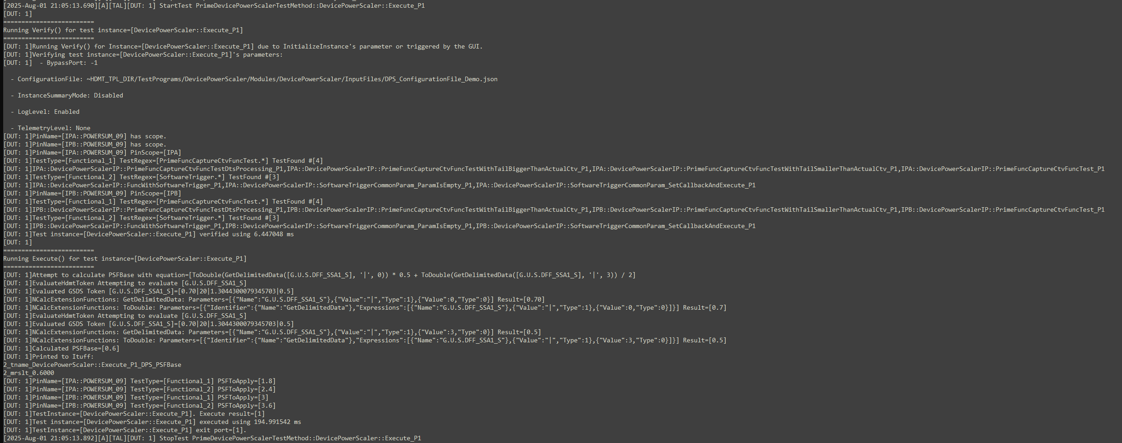
Console Example

